Slide 1
Intro OOP
Vu Tuan Hai

Slide 2
Timeline
Chap 1: C++
Chap 2: Overview of OOP
Chap 3: Object & Class
Chap 4: Operator & Overloading
Chap 5: Inheritance
Chap 6: Polymorphism
Chap 7: Advanced topics

Slide 3







Obj lifeloop
Construct
$\{$
$a is int= 1$
$b is int = 2$
$\{$
$c is int = 3$
$b is int = 4$
$\}$
$b = a + 1$
$\}$
Blocks
Stack
Read
$$a=1$$ | $$b=2$$
Update
$$c=3$$ | $$b=4$$
$$a=1$$ | $$b=2$$
Destruct
$$a=1$$ | $$b=2$$
$$c=3$$ | $$b=4$$
$$a=1$$ | $$b=3$$
Default variables

Slide 4
Obj lifeloop
Construct (new)
Start
Start
Read
Start
Update
Destruct (Delete)
(a) Empty heap
(b) Allocated heap
(c) Heap after free()
Pointer

Slide 5
Obj lifeloop
Time
class Rectangle{
private:
int width, length;
public:
void set (int w, int l);
int area() { return width*length; }
};
Raw Memory Allocation
+ Stack: through stack pointer
+ Heap (new): find free space on heap
+ Handcraft (malloc): sizeof
Note: padding, vptr, …
Init member variables
Constructor
Destructor
Q: What happens if constructor has exceptions?

Slide 6
Constructor

Slide 7
OOP obj & class
Class name + scope operator
class Rectangle{
private:
int width, length;
public:
void set (int w, int l);
int area() { return width*length; }
};
void Rectangle :: set (int w, int l) {
width = w; length = l;
}
Inside class
Outside class

Slide 8
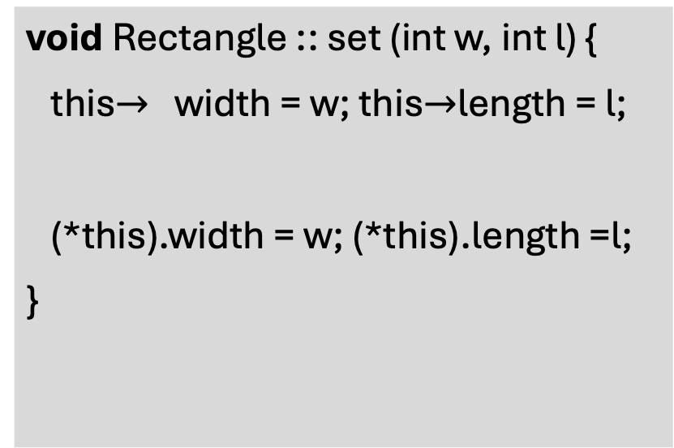
OOP obj & class: this pointer
class Rectangle{
private:
int width, length;
public:
void set (int w, int l);
int area() { return width*length; }
};
void Rectangle :: set (int w, int l) {
this$→$ width = w; this$→$length = l;
(*this).width = w; (*this).length =l;
}
This pointer
int main() {
Rectangle r;
r. set(3, 5)
}

